Slide 1

Translation
Exploring Azure’s cognitive services for language translation
Project by: Ivan MacLean - BESD
Notes:
Disclaimer: I’m not 100% sure if this is categorized as AI (since that and machine learning are used almost interchangeably sometimes), and the line on this project is pretty blurry (neural machine translation?), so I hope I’m not leading anyone into disappointment here.
Machine generated translation service, part of Microsoft Azure’s cloud offering.
Kind of like an API version of google translate
Main differentiating feature: it can be trained (neural translation system).
(Machine learning is the study of computer algorithms that allow computer programs to automatically improve through experience) - Prof. Tom M. Mitchell. National Academy of Engineering

Slide 2
Use Case
EVMF is an internal CRA application that allows business users to create correspondence templates.
Data is not protected (names, addresses, etc. are defined with generic placeholders)
Notes:
Dear (insert name), you owe us (insert dollar value), please pay by (insert date)

Slide 3
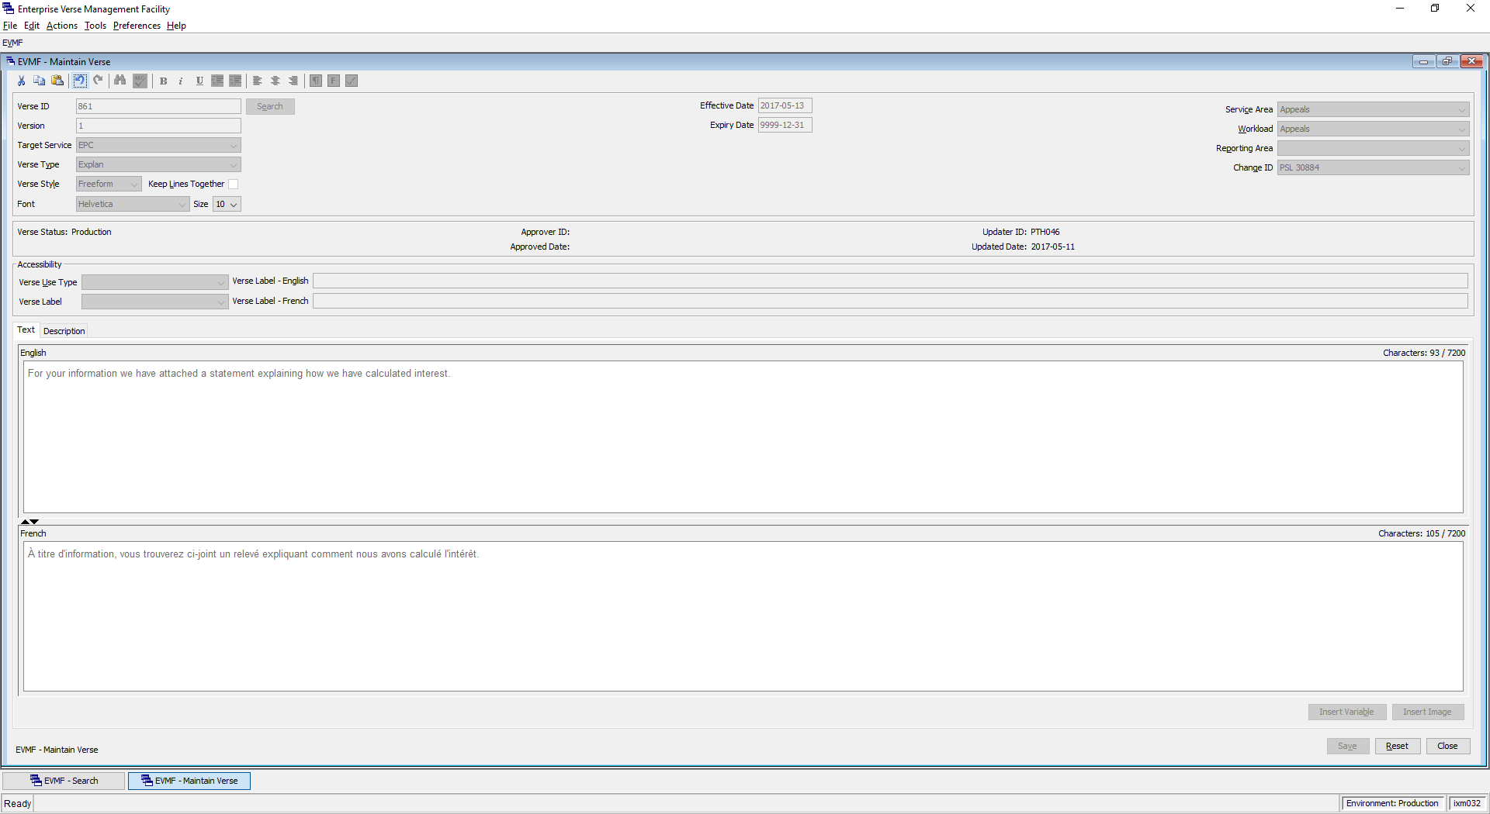
Notes:
Time saver. When creating content, I could enter text in one language, and have the system automatically translate to the other (instead of sending off for manual translation).
Manual approval process already in place, reduces risk of sending a bad translation to production.

Slide 4
Translator – Out of the box
First attempt: see how accurate/useful the Azure translator service is without any training.
Feed the translator some existing verses in English, and see how the French output compares to the actual French translation used by CRA.

Slide 5
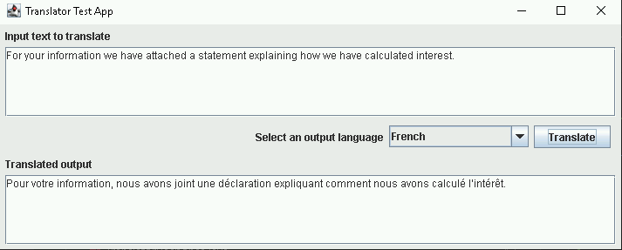
Notes:
Built a swing app in a virtual machine that directly calls the Azure translator API

Slide 6
BLEU Score
Bilingual Evaluation Understudy score
A measurement of the differences between an automatic translation and a human-created reference translation of the same source sentence
A higher score indicates a higher degree of similarity with the reference translation
Notes:
This gives us a way to compare the Machine translation with the original CRA translation.
We are making an assumption that the Human/CRA translation is correct, and we want to see how close the machine translation can get.
100 is perfect match, 0 is no match.

Slide 7
Example 1 – Out of the box
English (verse 6498) | We changed your return based on our recent letter.
CRA French | Nous avons modifié votre déclaration en fonction de notre récente lettre.
Azure French (Standard) | Nous avons changé votre retour en fonction de notre récente lettre. | BLEU Score: 58.59

Slide 8
Example 2 – Out of the box
English (verse 16816) | Documents can be certified by local officials such as doctors, accountants, lawyers, teachers or officials in a federal department or a provincial ministry.
CRA French | les documents peuvent être certifiés par des fonctionnaires locaux comme un médecin , un comptable , un avocat , un professeur ou un fonctionnaire du gouvernement fédéral ou provincial .
Azure French (Standard) | les documents peuvent être certifiés par des fonctionnaires locaux tels que des médecins , des comptables , des avocats , des enseignants ou des fonctionnaires d ’ un ministère fédéral ou d ’ un ministère provincial . | BLEU Score: 26.64
Notes:
Note: the Azure translation might still be good/valid, but it’s just not the way that CRA would say it.

Slide 9
Example 3 – Out of the box
English (verse 6409) | Based on the information you gave us, we changed your return.
CRA French | Nous avons modifié votre déclaration en fonction des renseignements que vous nous avez fournis.
Azure French (Standard) | D’après les informations que vous nous avez données, nous avons changé votre retour. | BLEU Score: 18.30

Slide 10
Custom Translator
We want to train the translator so that it can provide results that more closely match CRA’s communication style, thereby providing better (more relevant) recommendations.
Let’s conduct an experiment to see if we can achieve better results with a trained model.
Notes:
Can we achieve a higher BLEU score with a trained translator?

Slide 11
Data (Background)
Over 18,000 verses extracted from T1
Simple text verses only (no variables, delimiters, etc)
The plan:
Set aside 10% of the data set (1800 verses), and run it through the translator, capturing the results.
Train the translator with the remaining 90% (16,000 verses)
Run the 10% through the trained translator, capture results, and compare.
Notes:
To execute the experiment, I built an application that would take a spreadsheet of verses and hit the Translator API with each one

Slide 12
Example 1 – Trained System
English (verse 6498) | We changed your return based on our recent letter.
CRA French | Nous avons modifié votre déclaration en fonction de notre récente lettre.
Azure French (Standard) | Nous avons changé votre retour en fonction de notre récente lettre. | BLEU Score: 58.59
Azure French (Trained) | Nous avons modifié votre déclaration selon notre récente lettre. | BLEU Score: 53.88
Notes:
Highlights:
Used the correct form of “modifie” and “declaration”
Used “selon” instead of “en function”
Seems like a better translation even though the score is lower, but could just be due to short sentence length

Slide 13
Example 2 – Trained System
English (verse 16816) | Documents can be certified by local officials such as doctors, accountants, lawyers, teachers or officials in a federal department or a provincial ministry.
CRA French | les documents peuvent être certifiés par des fonctionnaires locaux comme un médecin , un comptable , un avocat , un professeur ou un fonctionnaire du gouvernement fédéral ou provincial .
Azure French (Standard) | les documents peuvent être certifiés par des fonctionnaires locaux tels que des médecins , des comptables , des avocats , des enseignants ou des fonctionnaires d ’ un ministère fédéral ou d ’ un ministère provincial . | BLEU Score: 26.64
Azure French (Trained) | les documents peuvent être certifiés par des fonctionnaires locaux tels qu ’ un médecin , un comptable , un avocat , un professeur ou un fonctionnaire du gouvernement fédéral ou provincial . | BLEU Score: 84.99
Notes:
Highlights:
Used the correct word for “teacher”
Used the correct phrase for “federal department or a provincial ministry”

Slide 14
Example 3 – Trained System
English (verse 6409) | Based on the information you gave us, we changed your return.
CRA French | Nous avons modifié votre déclaration en fonction des renseignements que vous nous avez fournis.
Azure French (Standard) | D’après les informations que vous nous avez données, nous avons changé votre retour. | BLEU Score: 18.30
Azure French (Trained) | Nous avons modifié votre déclaration en fonction des renseignements que vous nous avez fournis. | BLEU Score: 100.00

Slide 15
Example 4 – Trained System
English (verse 29100) | You did not give us the social insurance numbers of the payer and the recipient.
CRA French | vous ne nous avez pas donné les numéros d ’ assurance sociale du payeur et du bénéficiaire .
Azure French (Standard) | vous ne nous avez pas donné les numéros d ’ assurance sociale du payeur et du bénéficiaire . | BLEU Score: 100.00
Azure French (Trained) | vous n ’ avez pas fourni le numéro d ’ assurance sociale du payeur et du bénéficiaire . | BLEU Score: 56.11

Slide 16
Observation
How can the trained system obtain a lower score than the untrained system?
The lower score doesn’t mean the translation is bad. It just tried to translate it in a way that matches the other 16,000 verses we trained the system with.
Perhaps this verse’s human translation is a bit of an outlier?
Trajectory shift
This tool is not just a time saver (and not replacing human translator)
The service instead provides a suggestion/starting place that is consistent with the rest of CRA’s correspondence. This is something a human cannot easily do.
Notes:
Observation
The machine used to match before it was trained. After training the system, the machine changed its mind, and said “this is actually closer to other pieces of correspondence going out the door”.
Trajectory shift
If this was my first week on the job as a human translator at CRA, using this tool I wouldn’t have to be familiar with CRA’s correspondence style to provide relevant translations.
I wouldn’t need to have a set of rules defined like “this is the word we use for Teacher”
I didn’t even have to tell the system “this is the word we use for Teacher”. It identified this rule all by itself by analyzing other pieces of correspondence, and takes it into account when providing translations.

Slide 17
Results
After training the system, Microsoft actually provides a BLEU improvement score.
Original score: 43.96
New score: 69.14
Our own test results (using 1832 verses)
Original score: 38.55
New score: 58.50
Notes:
Turns out Microsoft does the experiment automatically for you. Whoops.
About a 20 – 25 point improvement in the trained system.

Slide 18
Next Steps
Integration with EVMF
Standalone application
Sometimes EVMF is just used as a data entry tool after a letter has already been translated as a whole.
Would be useful as a standalone tool provided directly to CRA translators.
Time saver: Microsoft claims that using machine translation as a first pass before human translation can improve productivity up to 50%
Notes:
Some users use EVMF to create multi-page letter templates (translated as a whole before ever reaching EVMF)
Some users use EVMF to create stand-alone verses used as system messages (could be created on-the-fly within the EVMF application)
Microsoft claims: “Machine translation has been used as a first pass by several of our language service provider (LSP) partners, before using human translation; it can improve productivity by up to 50 percent”.
https://www.microsoft.com/en-us/translator/business/faq/

Slide 19
Next Steps (cont…)
Implementation Options:
A single custom translator to provide consistency across all services and workloads within CRA.
Multiple custom translators to reflect differences between communication styles of services and workloads within CRA.
The more we feed the custom translator, the better it will get. Continually improve as users create more verses (assuming quality content).
Notes:
Example: would sending a letter to a tax-payer about qualifying for a benefit use the same kind of communication style as a letter accusing someone of tax-fraud?

Slide 20
Bottom Line
A tool that provides translation recommendations*
Assist with creating consistency across CRA correspondence
Bonus: Saves time/increases productivity
Notes:
*Recommendation = not replacing humans. Provides a starting point for human translation.
Recommendations are similar to actual correspondence going out the door.
Faster turnaround time for translations?

Slide 21
Questions

